Slide 1
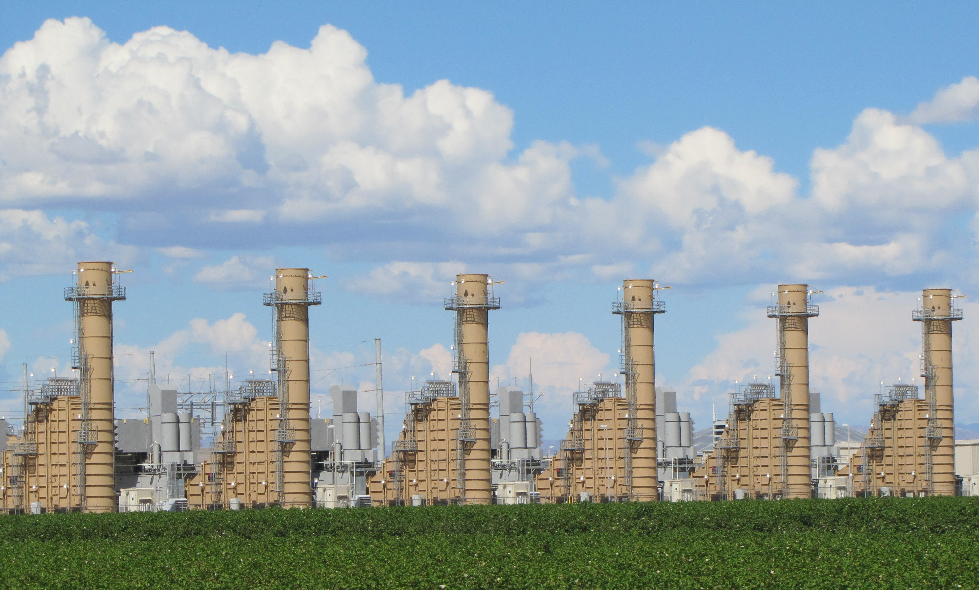
Emissions Inventory Report Compliance
Pinal County Air Quality Control District
2018 Permit Compliance Assistance Seminar
Dennise Flanigan

Slide 2

Why Report Emissions?
Federal Law
State, Tribal, Local (S/T/L)
Clean Air Act (CAA) authorized EPA
Regulate National Ambient Air Quality Standards (NAAQS)
Set Emission Thresholds Air Emissions Reporting Rule (AERR)
Monitor Hazardous Air Pollutants (HAP) and Criteria Pollutants
Create Regulations such as State Implementation Plans (SIP)
Federal and State Authorities authorized Pinal County Air Quality Control District (PCAQCD)
Issue Permits
Determine Compliance
Issue Notice of Violation(NOV)
Report Emissions Inventory (EI) to EPA via Emissions Inventory System(EIS)

Slide 3
What is Emission Inventory Data?
Estimations of Regulated Pollution Emissions in a defined area.
Types of Emission Inventory Sources
  Point Source – Data collected from large permitted stationary sources that estimates the amount of regulated pollutants emitted into the ambient air.
  Non-point Source or Area Source – Collected data from smaller sources such as gas stations, paint shops and others to estimate total area emissions.
  And Road, Non-road, and Event Sources.
EI data is compiled annually by PCAQCD, Arizona Department of Environmental Quality (ADEQ) and Gila River Indian Community (GRIC) for the geographical area known as Pinal County.
  The data is checked for errors, missing information, permit compliance, and possible modifications for future permit revisions.

Slide 4
What is Emission Inventory Data Used For?
The Federal, State, and local governmental agencies like PC, Gila River Indian Community (GIRC), and Maricopa Association of Governments (MAG) and private parties use the data to protect public health and the environment.
    Strategic planning
    Scientific studies
    Policy development such as SIPs
    Permit development
    Rule effectiveness
    Air quality modeling
    Obligations to international agreements

Slide 5
Circle of Emission Inventory
Industry Emissions
PCAQCD Emission Inventory
EPA
PCAQCD
Implement SIP

Slide 6
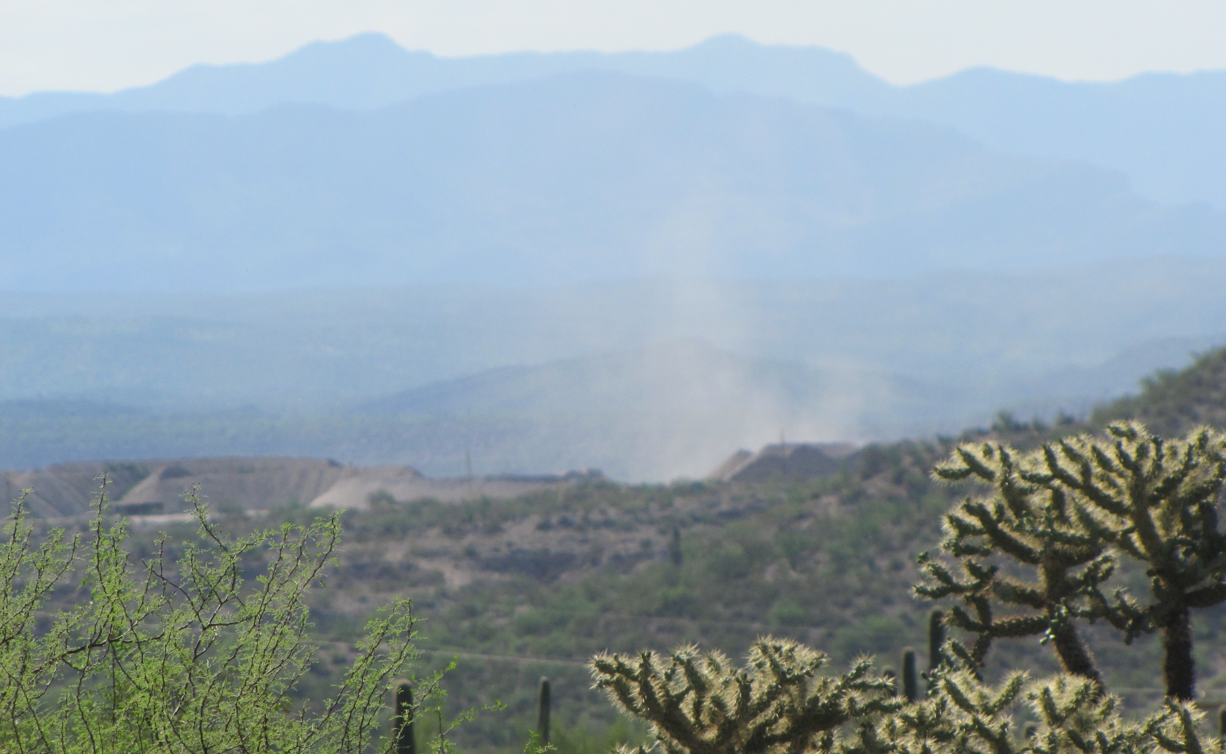
Who is Required to Submit an Annual Emissions Inventory Report?
The Pinal County Code of Regulations, §3-1-103, requires that all permitted sources complete and submit an Annual Emissions Inventory questionnaire.
Sources that must complete this questionnaire aka “Long Form” are:
  Title V sources
  Sources that are allowed to emit 80% of the major source threshold
  Some other complex sources
Based on a source’s potential to emit certain sources only submit information as a semi-annual/annual compliance report aka “Appendix A.”

Slide 7
Emission Inventory Reports
Appendix A Semi-annual and Annual
Long Form
Short version of the appropriately named Long Form.
Defined in permit and summarized as an appendix.
Modified for source’s potential to emit regulated pollutants.
Reports are required every 6 months per §3-1-083.
  Some sources are allowed to report annually based on their potential to emit.
Seven Sections
  1 Facility Identification and Mailing Address
  2 Data Certification
  3 Stack and Vent
  4 Equipment and Control Device
  5 Process Identification
  6 Pollutant
  7 Sample Calculations

Slide 8
Filling Out Emission Inventory
Report, Questionnaire, Survey, Form, Packet…. aka
Appendix A and Long Form!

Slide 9
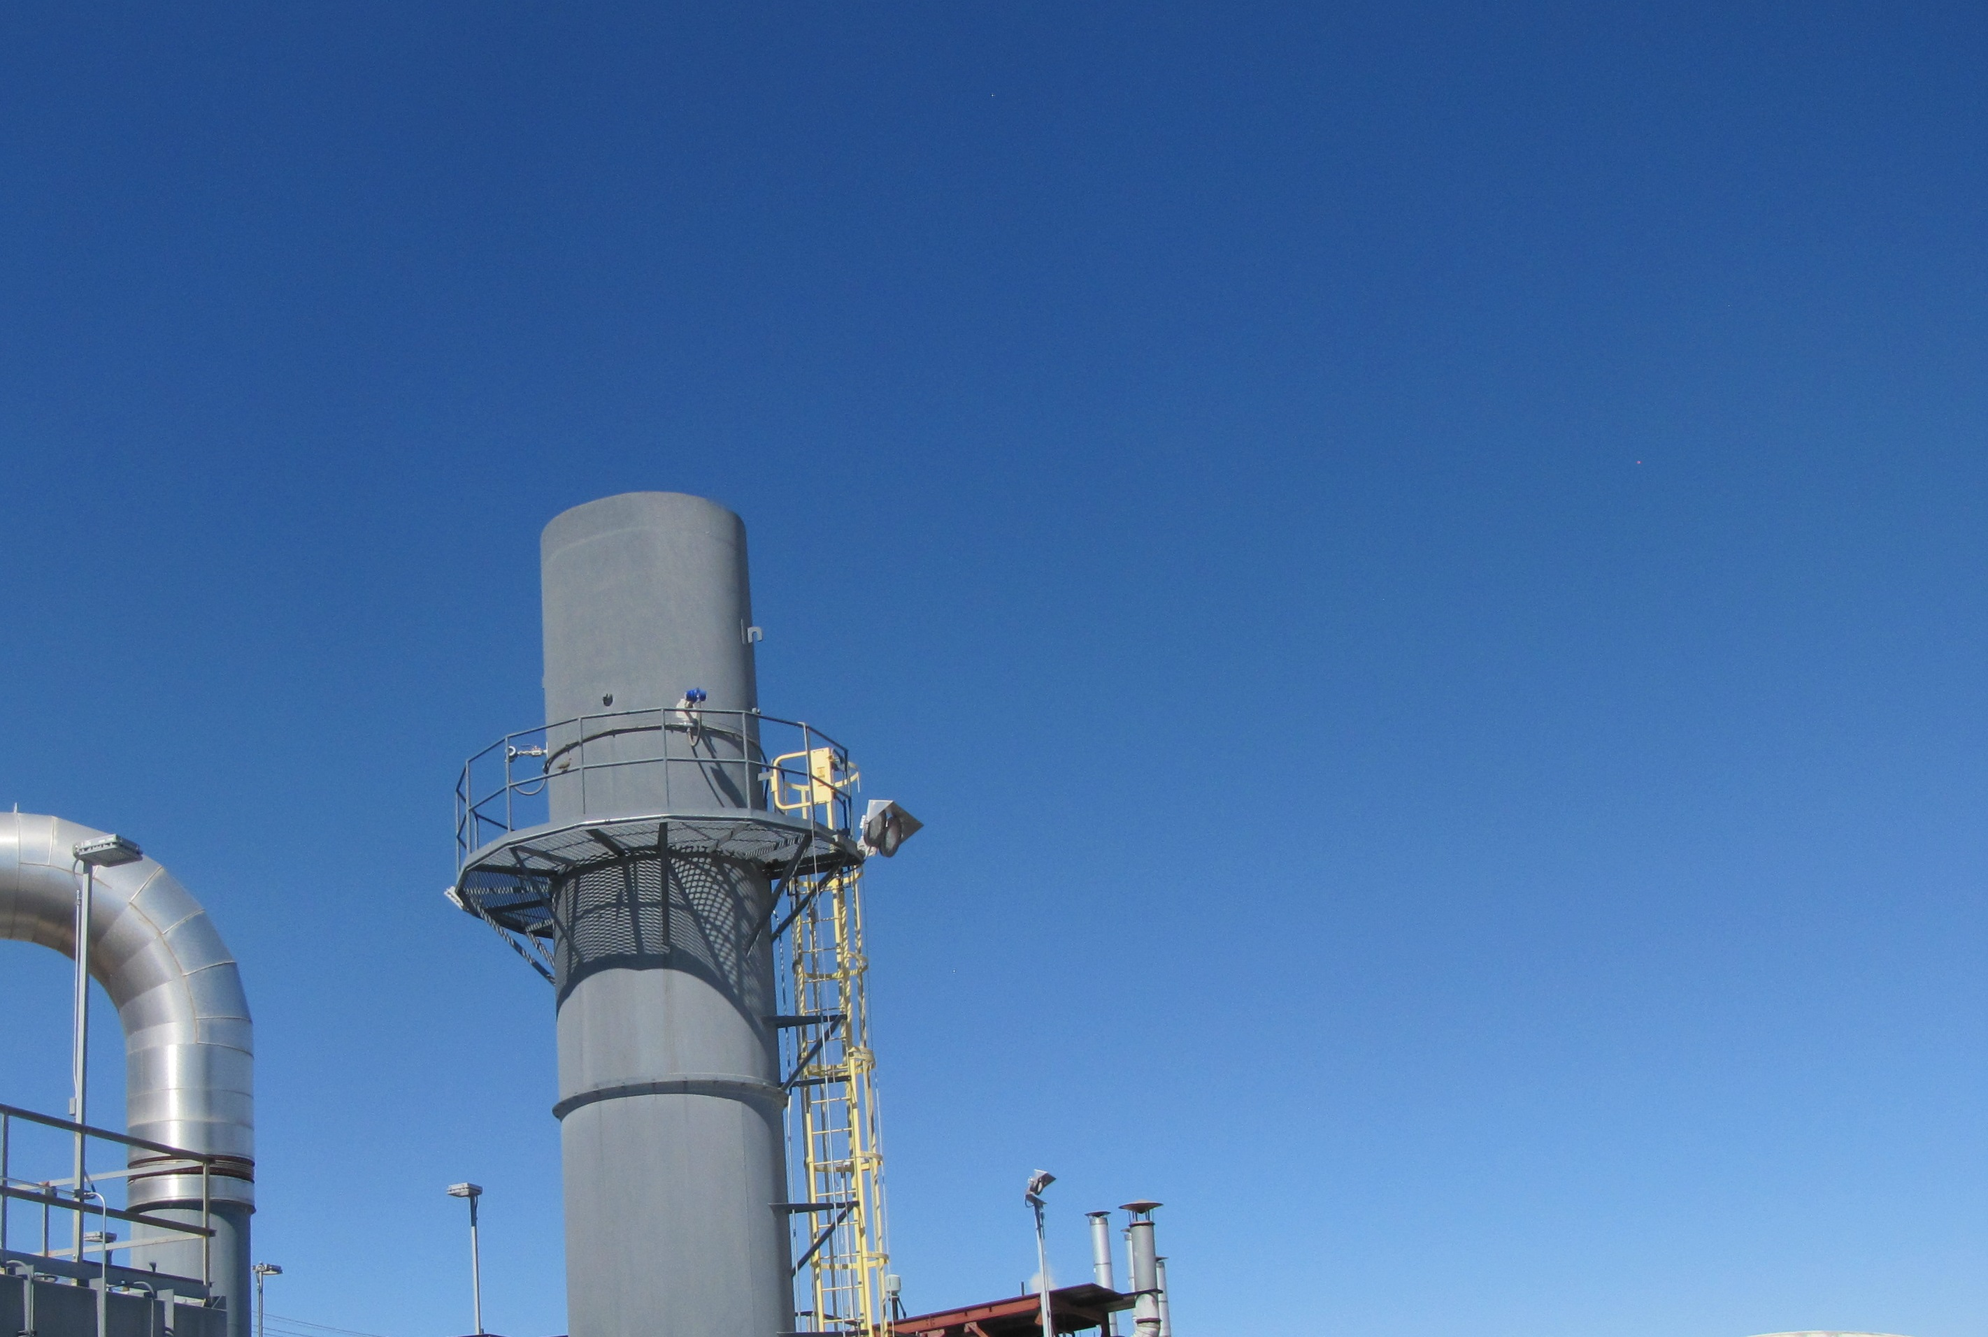
Emission Inventory Appendix A Report
Semi-annual
Annual

Slide 10
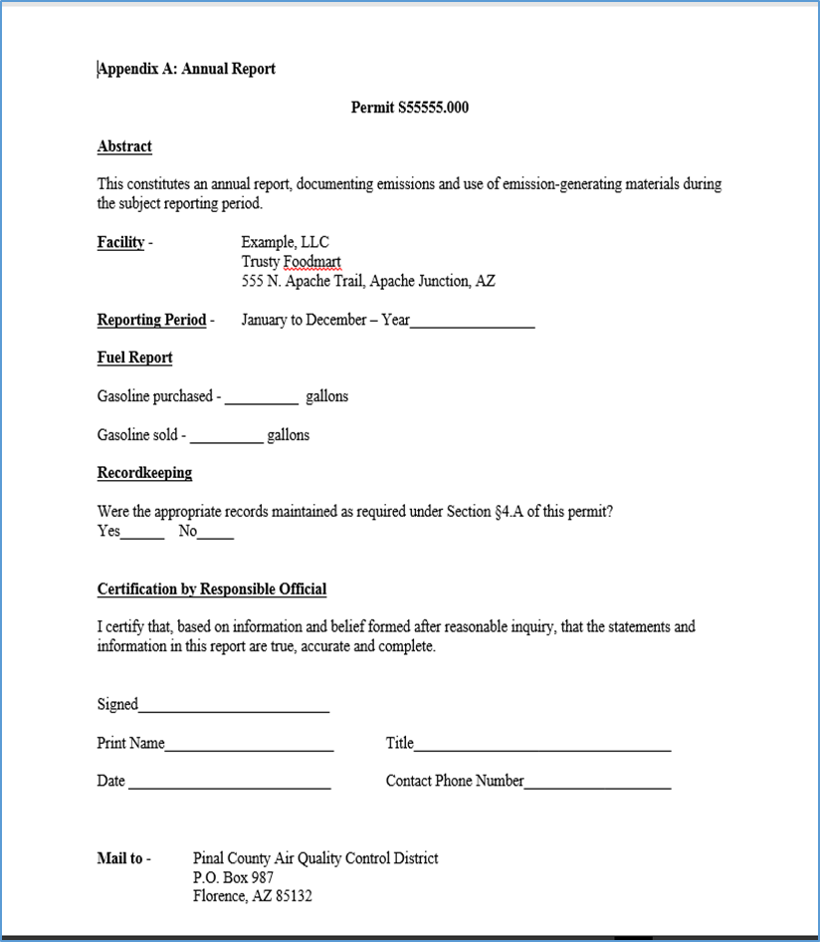
Appendix A Semi-annual and Annual Reports
What to check:
  Permit number is current.
  Facility name is the legal name.
  Site address is current.
  Input material and/or equipment data
    Please mark N/A rather than leave data fields blank. If you have questions feel free to call.
  Have the RESPONSIBLE official sign the certification and legibly print their legal name and title.
      “Booboo” is most likely not a legal name, but then you never know…
  Mail or hand deliver original Appendix A to PCAQCD.
  Keep a copy for your records.

Slide 11

Emission Inventory Long Form Report

Slide 12
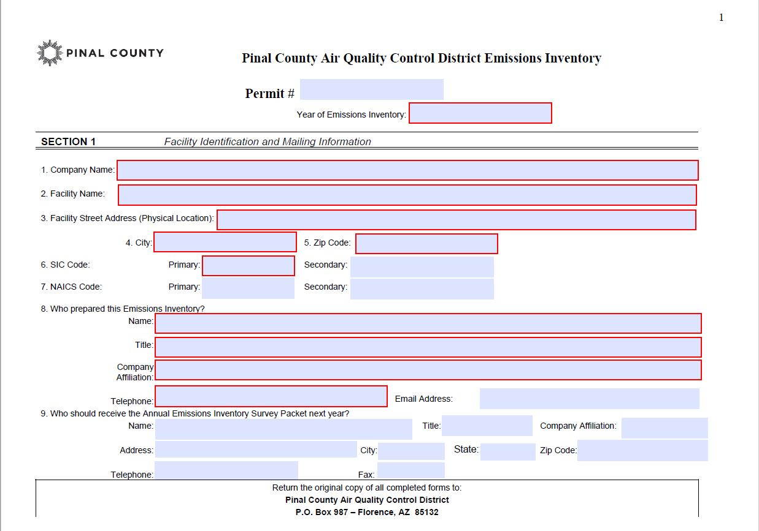
Emission Inventory Long Form Section 1
Find information regarding filling out the Long Form in the overwhelming six page instruction document posted on:
http://www.pinalcountyaz.gov/AirQuality/Pages/IndustrialPermitsProcess.aspx
#1 Company Name is the legal entity.
#’s 2 & 3 Facility Name and Street Address is the site of emissions.
#’s 6 & 7 North American Industrial Classification System(NAICS) codes are preferred over SIC.
#’s 8 & 9 Current contact phone numbers are greatly appreciated as are email addresses!

Slide 13
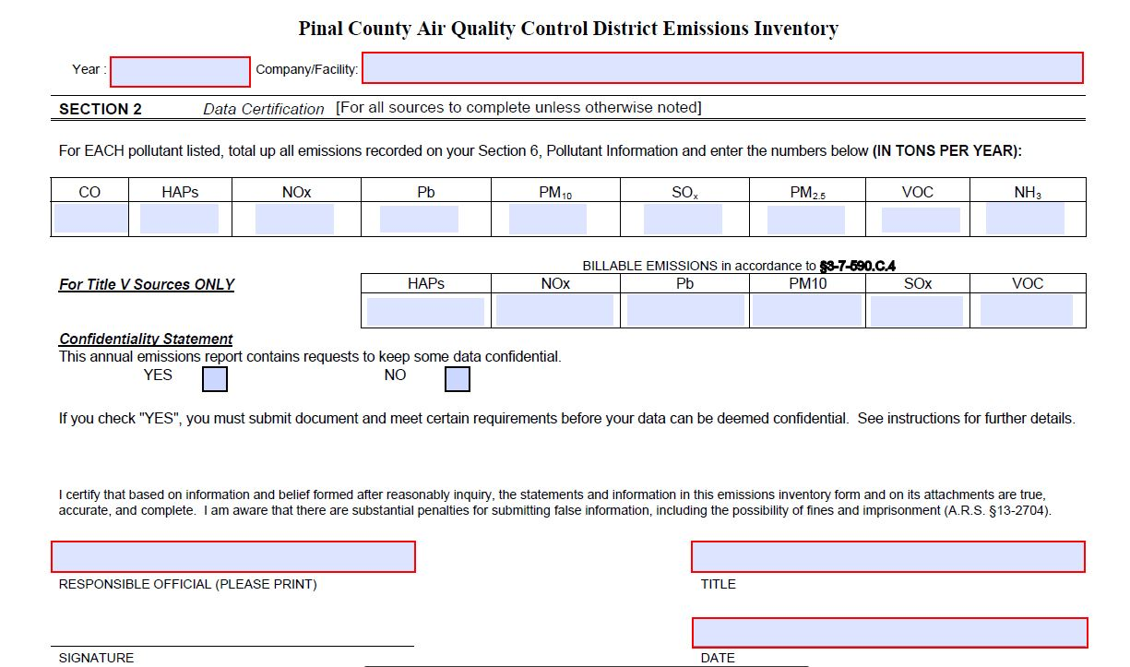
Emission Inventory Long Form Section 2
This section is the summary of the information being submitted.
Please list emissions in TONS PER YEAR.
Billable Emissions section is only for Title V permits.
Confidentiality Statement:
  Trade Secret
  Detrimental to an ongoing investigation
RESPONSIBLE OFFICIAL signature.

Slide 14
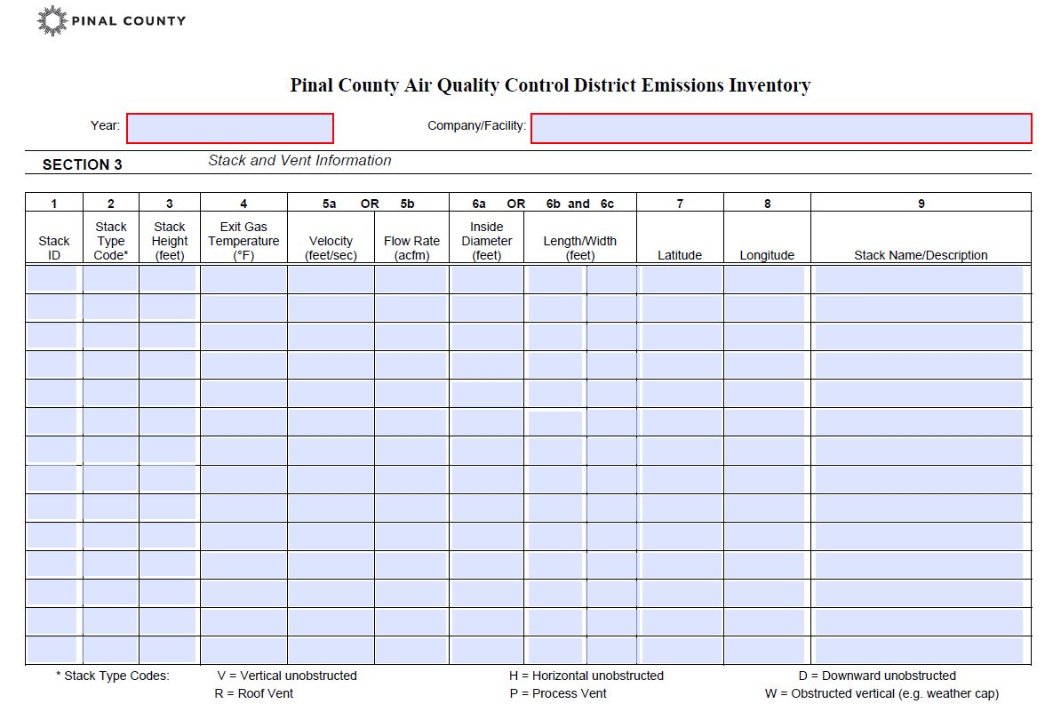
Emission Inventory Long Form Section 3
Points of emissions such as stack, pipe, vent, flue, or outlets that release pollutants into the ambient air.
#1 Use the same Stack ID each year.
  If a new outlet is added give it a different Stack ID; do not reuse an old ID.
#9 Stack Description is helpful when there are several processes using the same outlet.

Slide 15
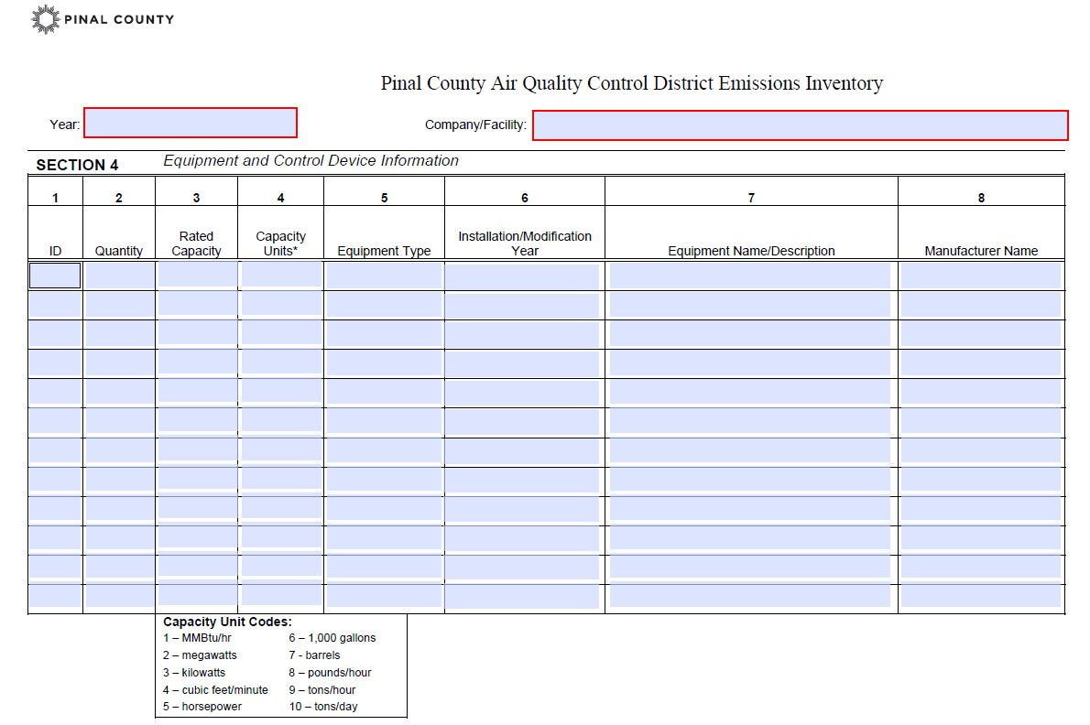
Emission Inventory Long Form Section 4
List only permitted emissions emitting or control equipment.
#1 Use the same Equipment or Device ID each year.
  If new equipment or device is added give it a unique ID and do not reuse an old ID.
#4 Use the Capacity Unit Codes list below the column. For air or liquid control devices use cubic feet per minute(cfm).

Slide 16
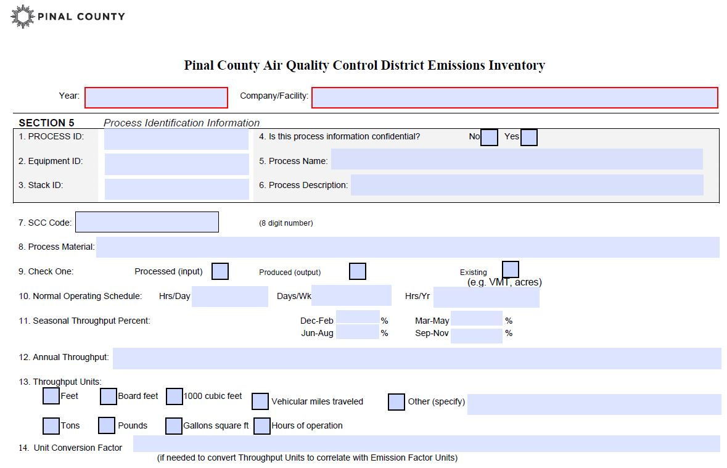
Emission Inventory Long Form Section 5
Process Identification Information is the KEY to understanding emissions.
#1 Use the same Process ID each year. The Process ID can not be used for any other process at this facility. Do not reuse an old ID.
#2 and #3 Must match and correspond with IDs given in SECTIONS 4 and 3.
#6 Process Description refers to an activity that emits a regulated pollutant from a single #8 Process Material type.
#7 Source Classification Codes (SCC) were updated November 2017.
#9 Existing - not directly used such as hours, vehicle miles traveled, or acres.

Slide 17
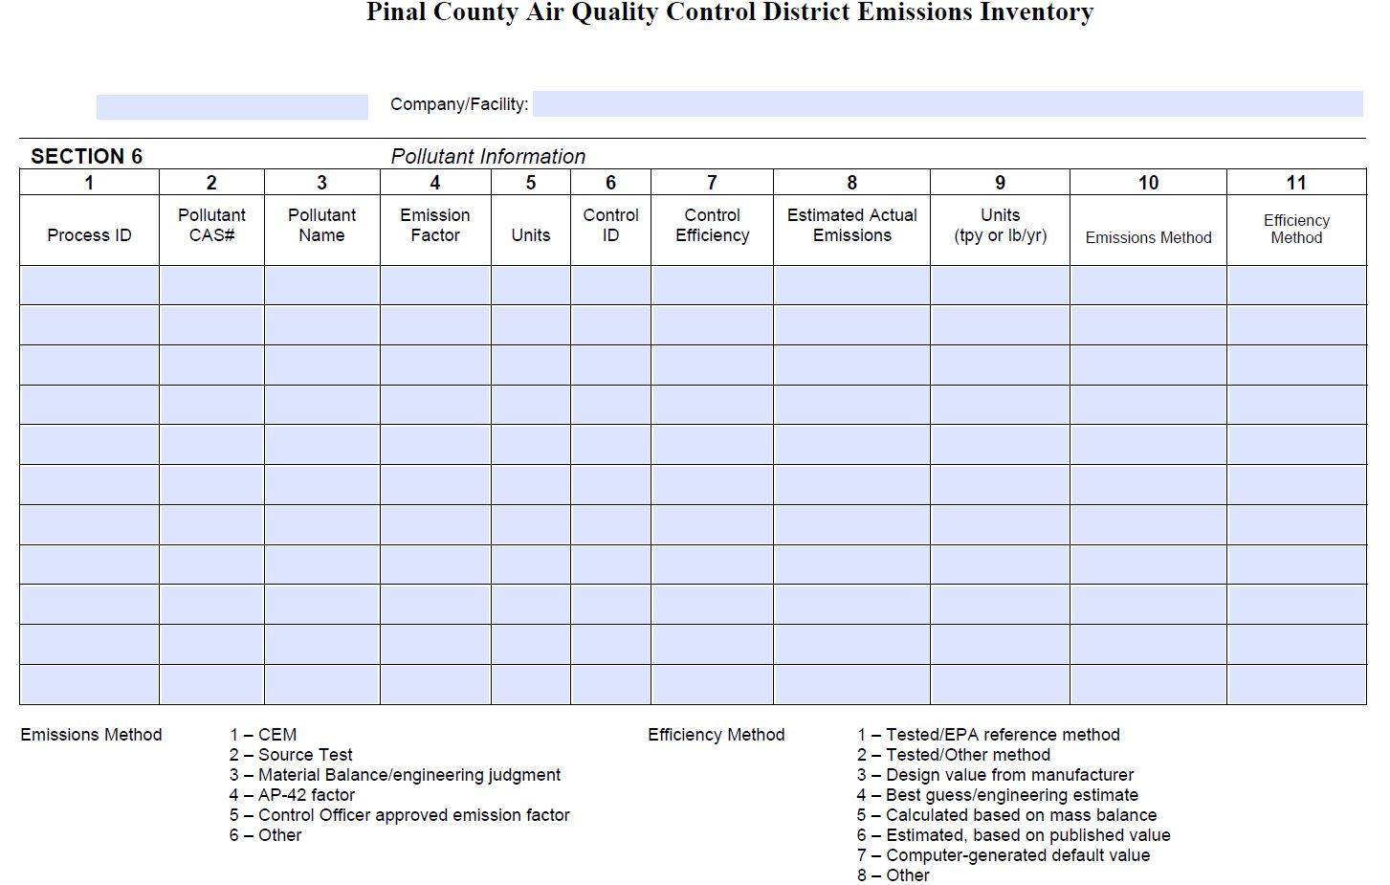
Emission Inventory Long Form Section 6
This section breaks out each regulated pollutant and applies the Emission Factor and Control Efficiency used for each process.
#1 The Process ID must match the ID given in SECTION 5 for each Pollutant.
#2 The Chemical Abstracts Service (CAS) number must be correct and match the #3 Pollutant Name.
#4 Uses SECTION 5’s #12 Annual Throughput to calculate amount of pollutant emitted. Watch Units!
#6 Control ID must match SECTION 4 #1.
#’s 10 & 11 Method numbers at bottom of page may be different than EPA’s EIS Method numbers.

Slide 18
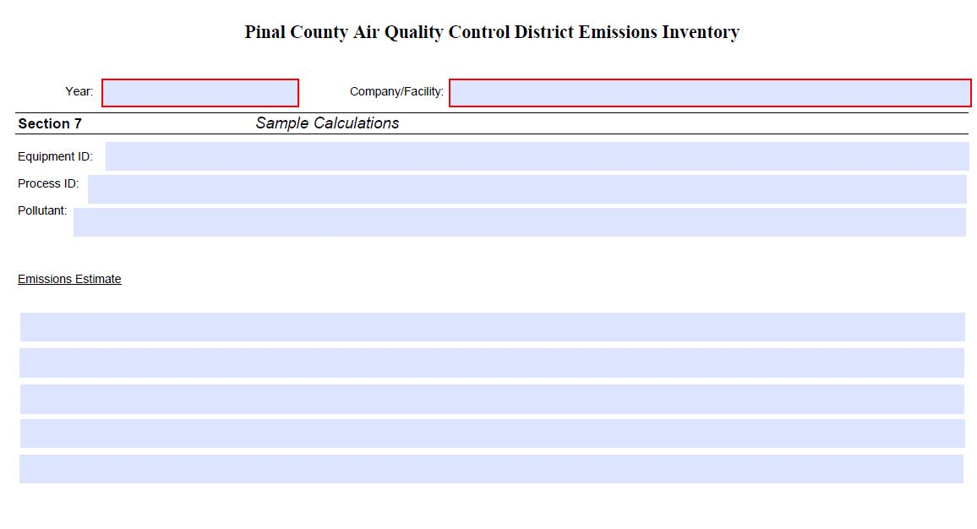
Emission Inventory Long Form Section 7
A sample calculation should be provided for each different type of process.

Slide 19
Helpful Tips
Verify information in SECTION 2 Total Emissions matches SECTION 6 Process Emissions.
PM 2.5 emissions cannot be larger than PM 10 emissions.
Use the most current source test emissions factors.
Provide current contact information for the person filling out the EI forms.
Make a copy of all your forms and keep for your records.
Please number all of the pages.

Slide 20
Important Takeaways
Do not change ID numbers.
Do not reuse ID numbers.
Long Form EI reports are due by April 30th, unless stated otherwise in the permit.
Appendix A EI reports are due by July 30th and January 30th, unless stated otherwise in the permit.
Send in originals with legible Responsible Official name and signature as defined in §3-1-030.18 (Owner, President, VP, or Officer of the facility).
Mail or hand deliver originals to:
  PCAQCD
  PO Box 987
  31 N Pinal Ave. Bldg. F
  Florence, Arizona 85132

Slide 21
Where to get Help
Visit PCAQCD web site and download the instruction guide at:
http://www.pinalcountyaz.gov/AirQuality/Pages/IndustrialPermitsProcess.aspx
Call or email if you have questions; we are pretty nice after our first cup of coffee/tea.
  Bob Farrell Phone: 520.866.6949
  Email: Bob.Farrell@pinalcountyaz.gov
  Anu Jain Phone: 520.866.6931
  Email: Anu.Jain@pinalcountyaz.gov
  Dennise Flanigan Phone: 520.866.6806
  Email: Dennise.Flanigan@pinalcountyaz.gov

Slide 22
Questions?

